Slide 1
Robot Art Project
Elements of Design

Slide 2
Elements of Design
Direction
Repetition
Value
Form
Size
Dominance
Emphasis
Line
Balance
Contrast
Repetition
Shape
Movement
Color
Pattern
TeXTure

Slide 3
Discussion Questions
What elements of design do you see in each of these paintings?
Which one stands out to you the most? Why?
What elements could you program the Scribbler robot to replicate?
Which elements would be the most difficult to program? Why?
What other tools could you use to add various elements to your work?

Slide 4
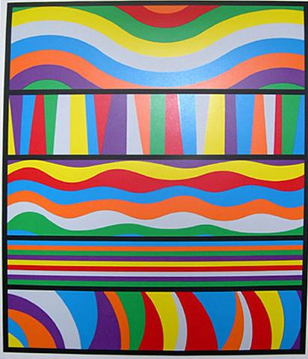
Presta Sol Lewitt

Slide 5
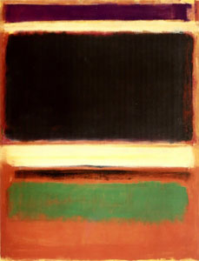
No. 3 Mark Rothko

Slide 6
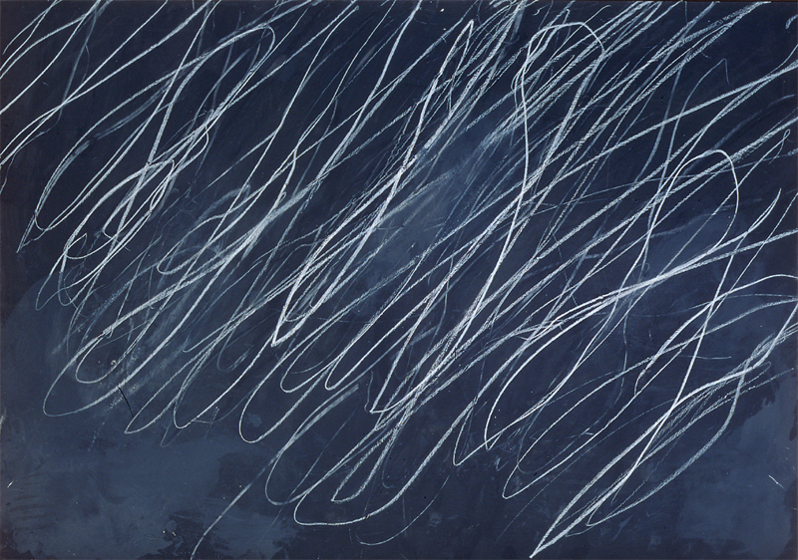
Untitled Cy Twombley

Slide 7
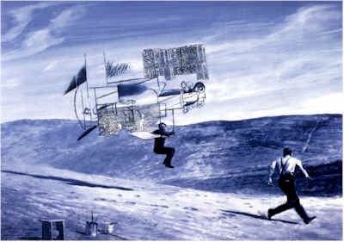
Picasso and Braque Mark Tansey

Slide 8
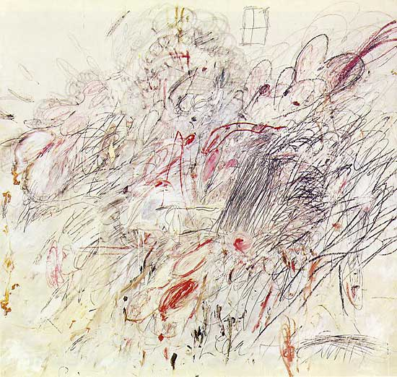
Leda and the Swan Cy Twombley

Slide 9
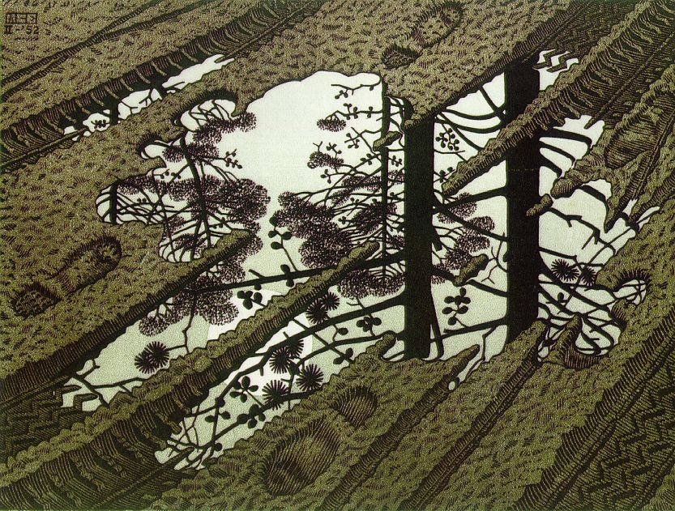
Puddle MC Escher

Slide 10
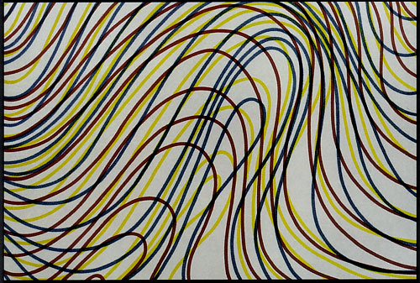
Wavy Lines with Black Border Sol LeWitt

Slide 11
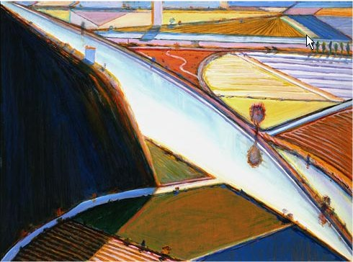
Farm Study Wayne Thiebaud

Slide 12
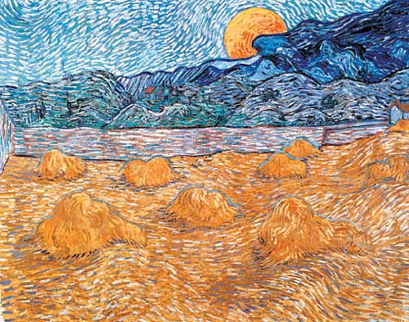
Rising Moon: Haycocks Vincent Van Gough

Slide 13
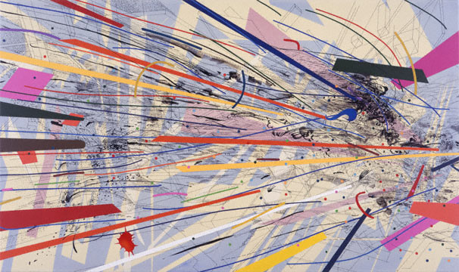
Excpert (Supernaturalist Envasion) Julie Mehretu

Slide 14
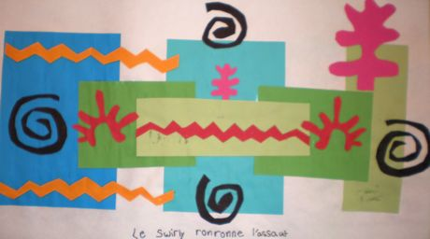
Le Swirly Henri Matisse

Slide 15
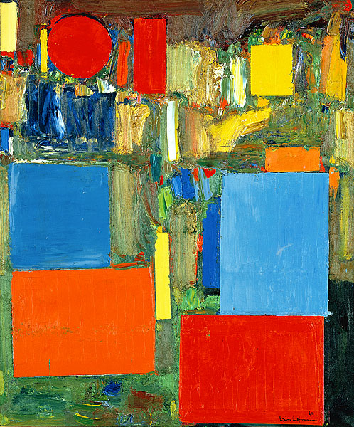
Pre-Dawn Hans Hoffman

Slide 16
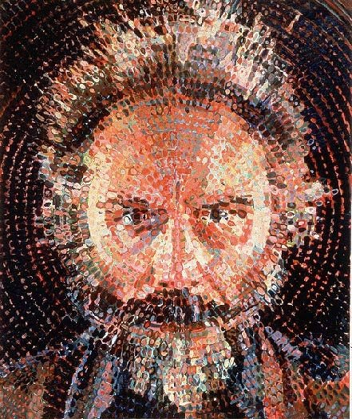
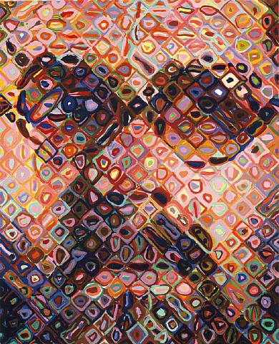
Lucas Chuck Close
Self Portrait Chuck Close

Slide 17
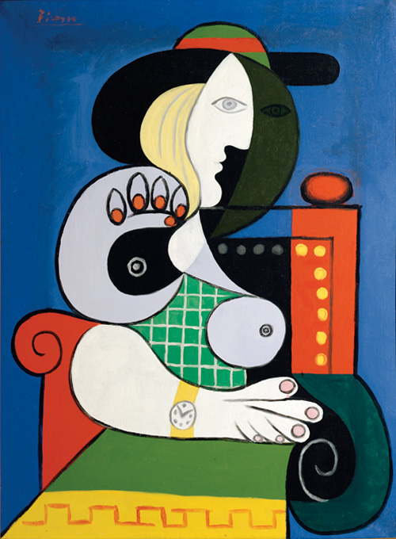
Seated Woman Pablo Picasso

Slide 18
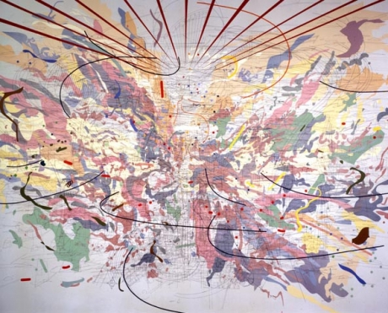
Looking Back to a Bright New Future Julie Mehretu

Slide 19
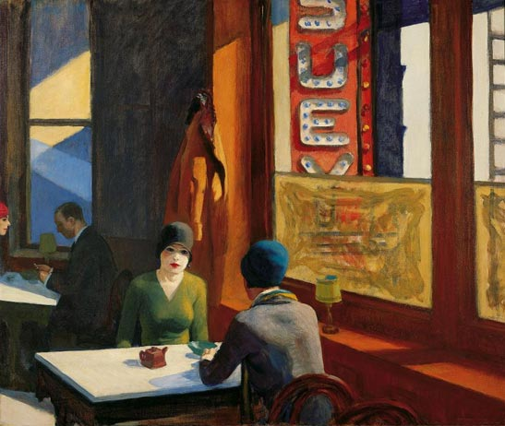
Chop Suey Eward Hopper

Slide 20
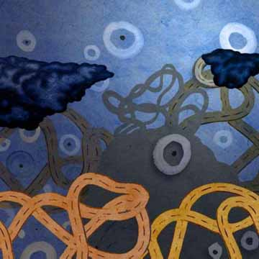
On the Road Charles Wiese

